Slide 1
Chapter 5
Biological Diversity and Conservation
5.1 Vanishing Species

Slide 2
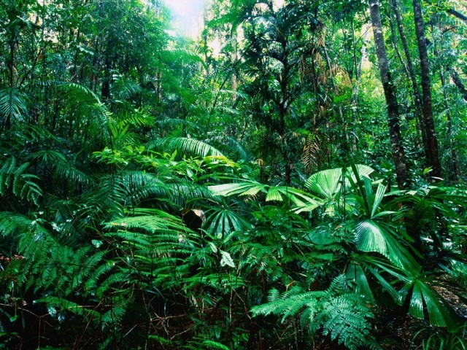
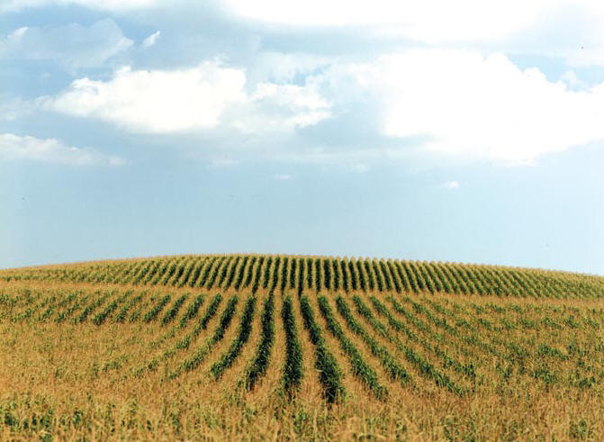
Biodiversity
The variety of species in a specific area
  Example: Rainforest vs. Cornfield
  Tropical regions contain 2/3 of all species

Slide 3
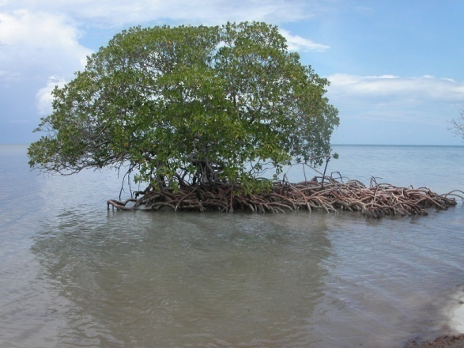
Studying Biodiversity
Mangrove Island example
Levels of the rainforest
Catalogue organisms of the coral reef
Radio collars
Compare DNA to isolated organisms

Slide 4
Importance of Biodiversity
Organisms rely on each other
  Food, pollination, decomposition
Stability
  Loss of one species has less affect
Humans
  Food, oxygen, clothes, furniture, shelter, medicine

Slide 5
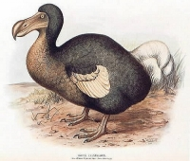
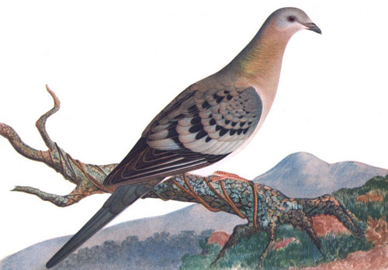

Loss of Biodiversity
Extinct Species- No individuals living
  Due to habitat loss
  May be losing 1 species/day
  Ex: Passenger pigeon, Dodo,

Slide 6
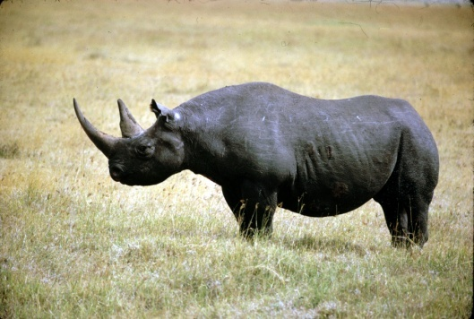
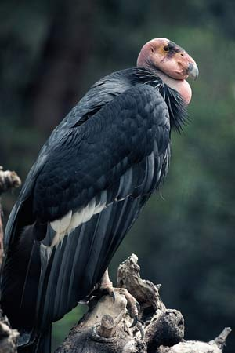
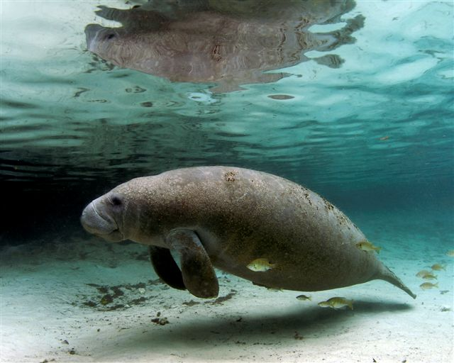
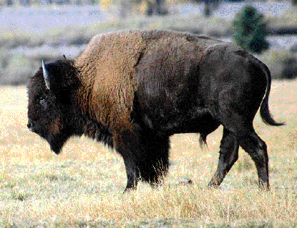
Endangered Species
Population so low, extinction is possible
Florida panther, california condor (habitat)
Black Rhino (poachers)
Manatee (boats)
Bison
  20 million→ 15,000
  1850 Now

Slide 7
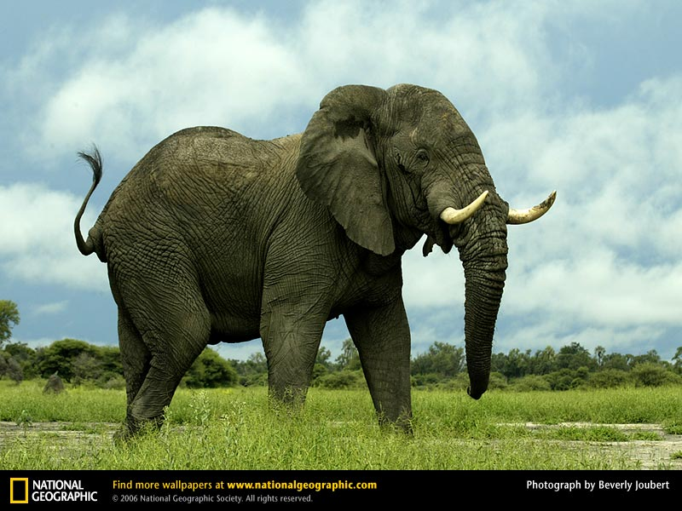
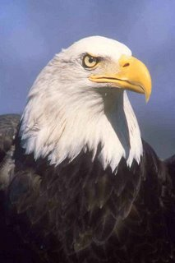
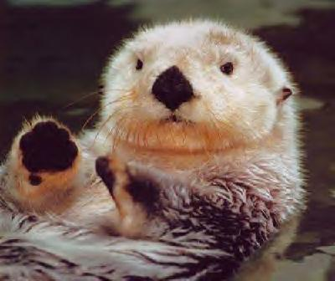
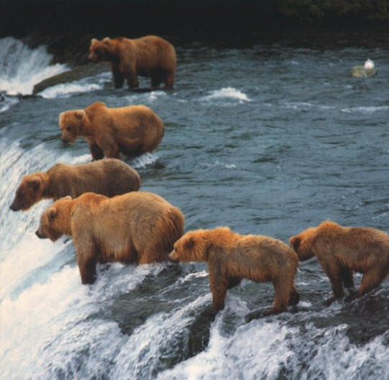
Threatened Species
Population declines rapidly
African Elephants
  3 million → 700,000 in 20 years
Bald Eagle, Sea Otter, Grizzly Bear

Slide 8
Threats to Biodiversity
Habitat Loss- clearing land
  Rainforest, farmland, housing, coral reef (temp.)
Habitat Fragmentation- separation of area
  Isolated from others (predator, prey, mates)
Edge Effect- different conditions along boundary
  House cats/birds
  Roads break the canopy
Habitat Degradation- damage by pollution

Slide 9
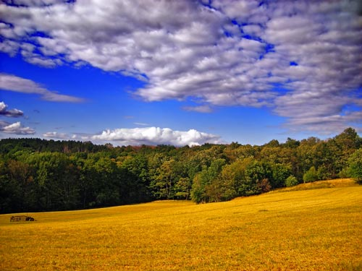
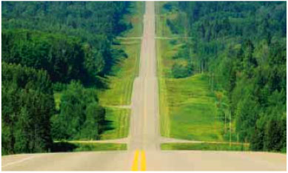
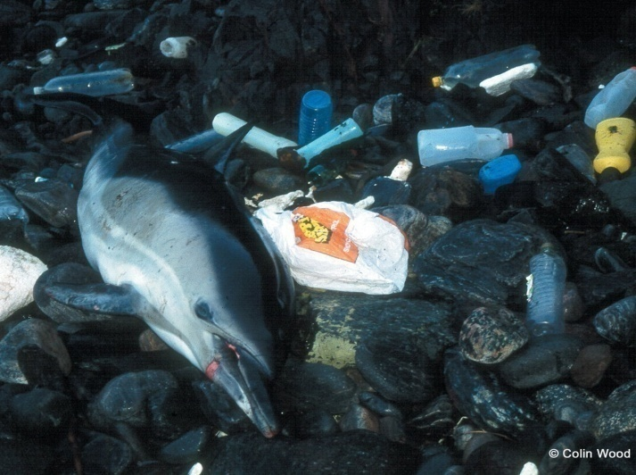
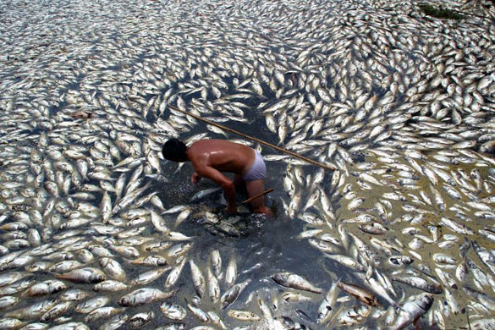
Threats to biodiversity

Slide 10
Pollution
What is pollution?
  Contamination of any part of the environment
What are the types of pollution?
  Air
  Water
  Land

Slide 11
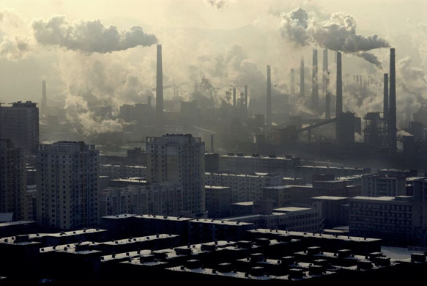
Air Pollution
Greatest source- Fossil fuels
Fossil fuel emissions
  Gases- CO, CO2, SOx (coal), NOx (automobiles)
  Particulates- unburned carbon

Slide 12
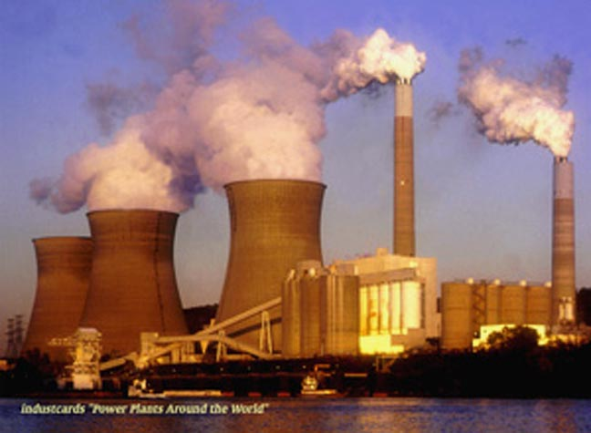
Shippingport

Slide 13
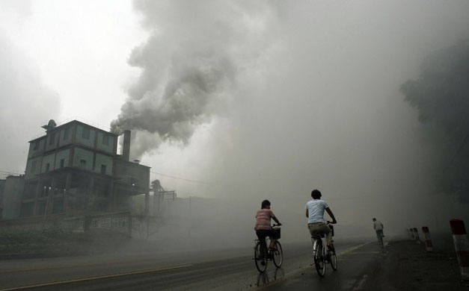
Air Pollution
What are CFCs?
  Chlorofluorocarbons
  Destroy O3 which blocks UV rays
  Styrofoam, Freon, aerosol cans (1977)

Slide 14
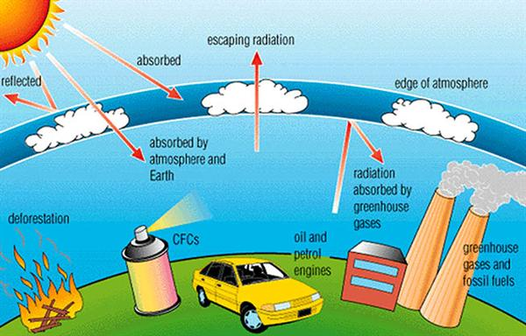
Air Pollution
Acid Rain
  Kills plants, soil, pH of lakes
Greenhouse Effect- atmosphere retains heat
  Caused mainly by CO2 increase
  Trend or serious problem?

Slide 15
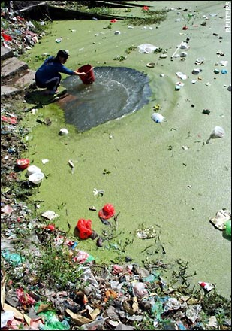
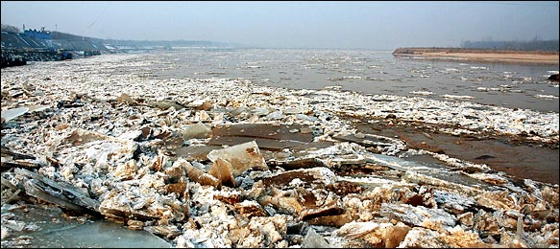
Water Pollution
Usable freshwater- 0.1% of all water
“Don’t drink the water”
  Cholera, Ameobic dysentery, Hepatitis, Typhoid Fever

Slide 16
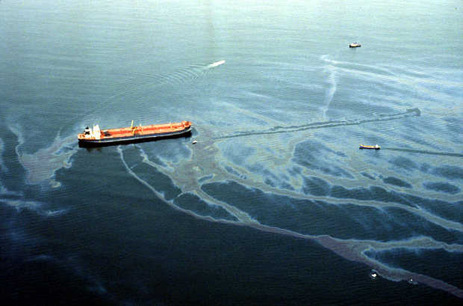
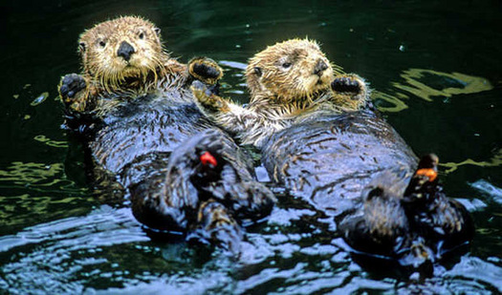
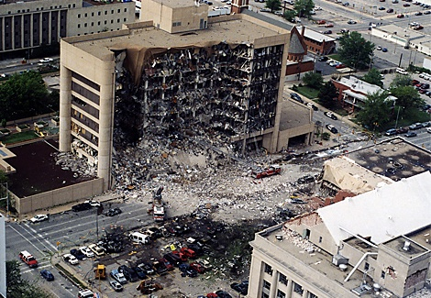
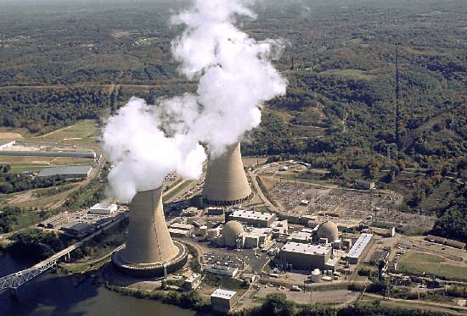
Water Pollution
Inorganic pollutants
  Fertilizers, sediments, thermal
Organic pollutants
  Oil, pesticides, sewage

Slide 17
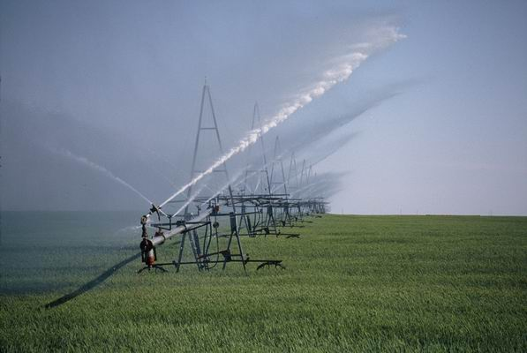
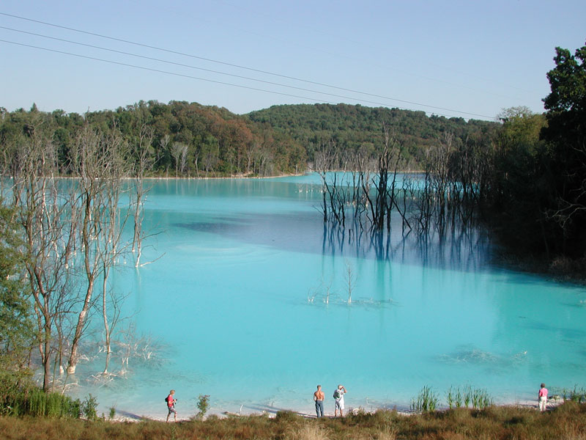
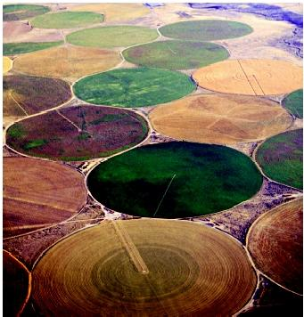
Water Pollution
Groundwater
  ½ the US depends on groundwater for drinking
  Seepage contamination
    Oil and toxic material
Overuse: Ogallala Aquifer in Midwest

Slide 18
Land Pollution
How much garbage do you produce each day?
What happens to that garbage?
Landfills (burned or buried)
  Two types of waste:
  Biodegradable- organic waste (breaks down)
  Non-biodegradable- do not break down
  Ex: DDT, toxic metals, plastics, radioactive wastes

Slide 19

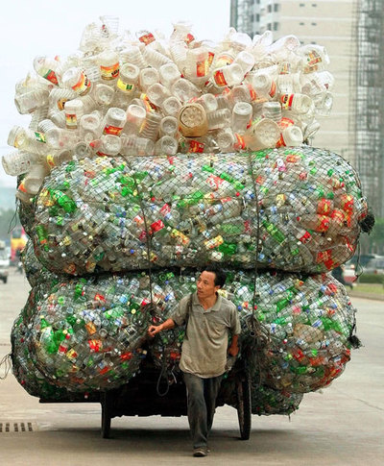
Land Pollution
What can we do?
Recycle- reuse of non-renewable resources
  Ex: Metals, glass, paper, plastic

Slide 20
When demand exceeds supply
As the population grows, so does the demand for:
Food
Water
Living Space
Fossil Fuels
Transportation
Clothing

Slide 21
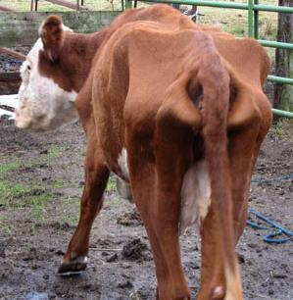
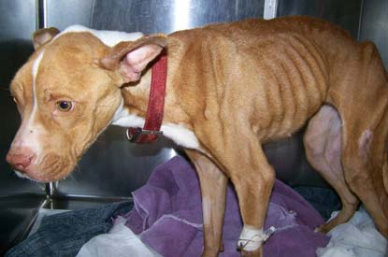
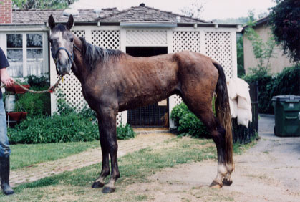
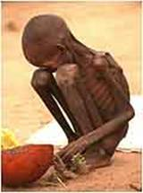
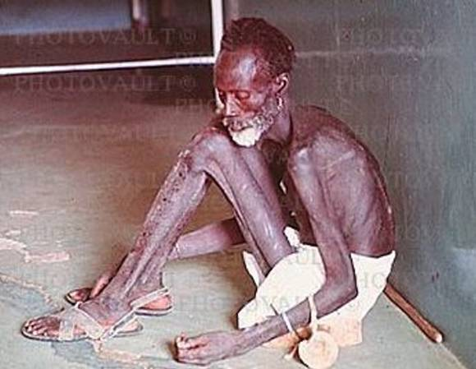
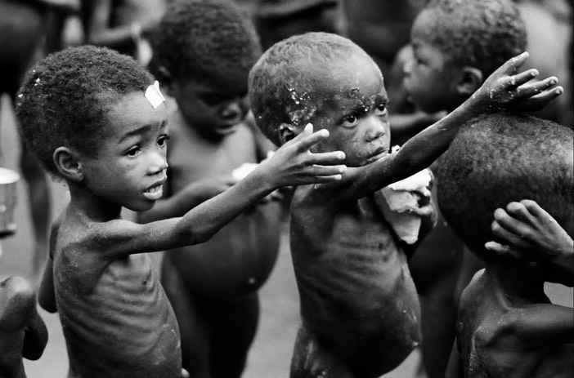
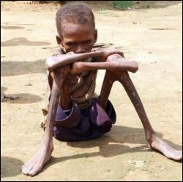
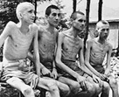
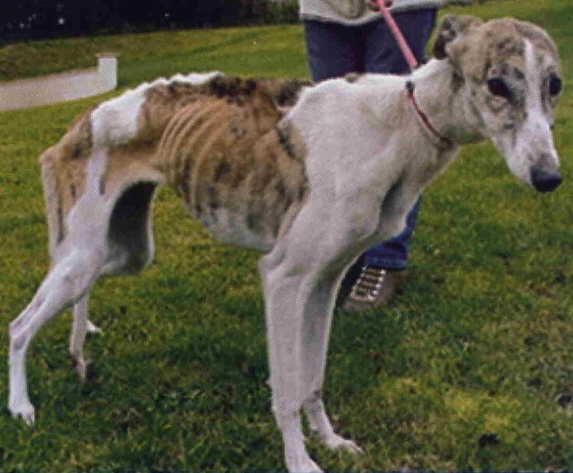
Starvation
About 3 of every 10 children in the world are starving.

Slide 22
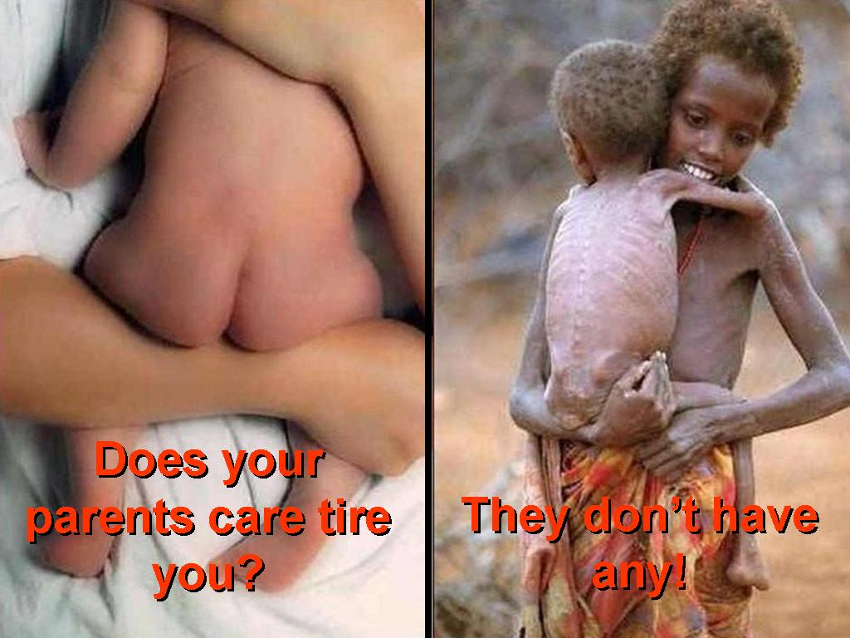
Starvation

Slide 23
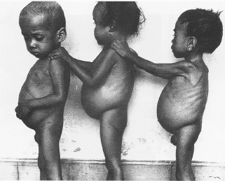
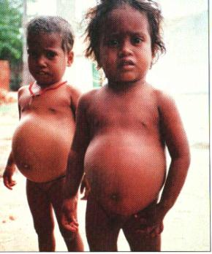
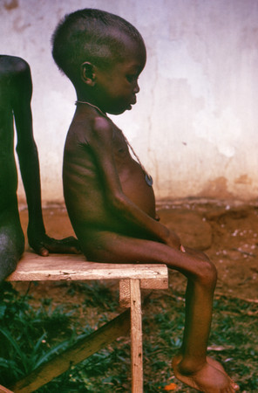
Kwashiorkor- protein deficiency
Abdomen is filled with fluid and liver is enlarged.

Slide 24
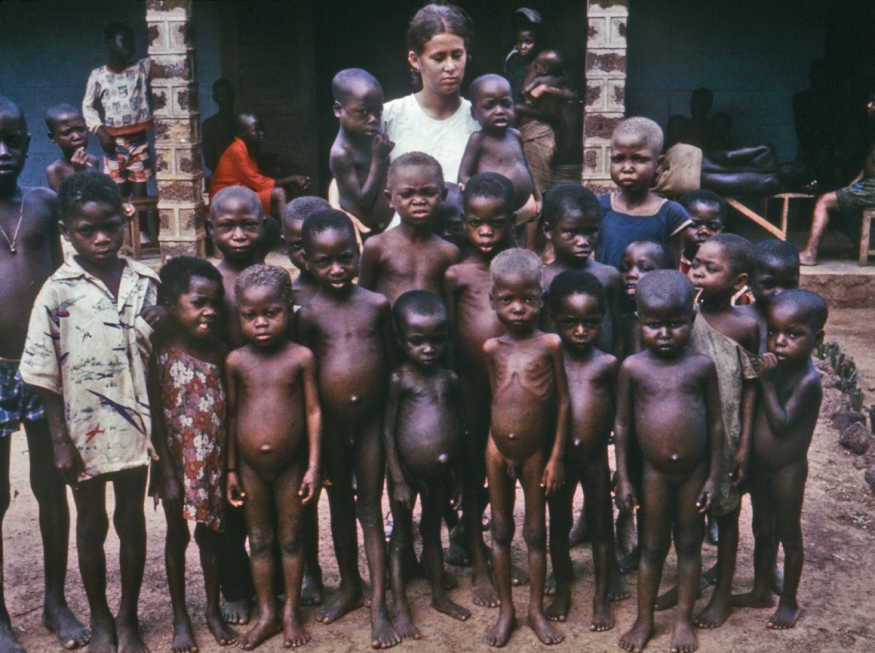
Kwashiorkor

Slide 25
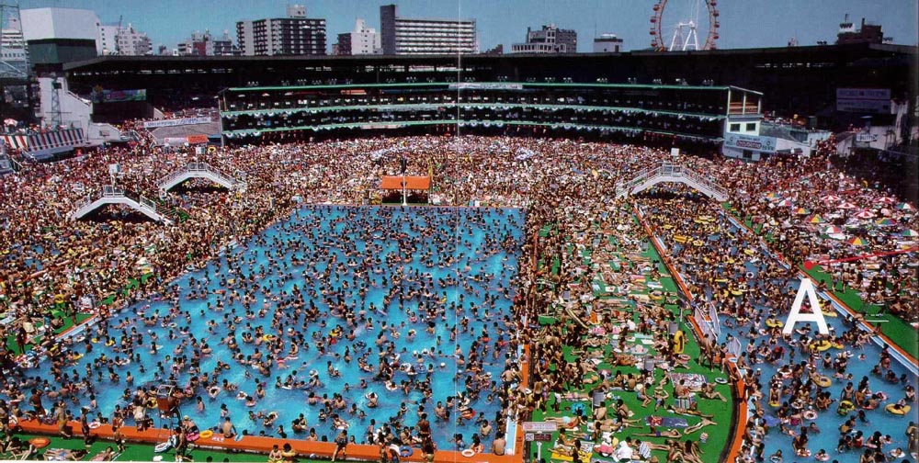
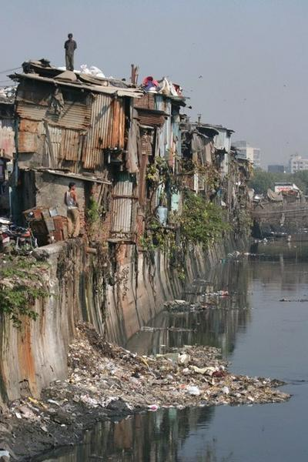
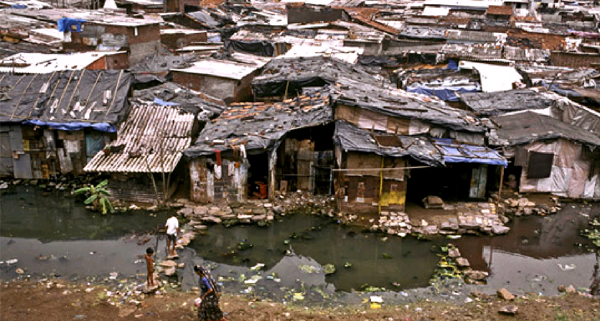
Living space

Slide 26
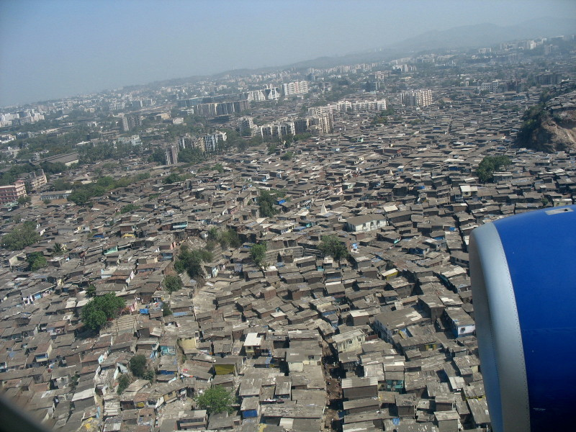
Living Space

Slide 27
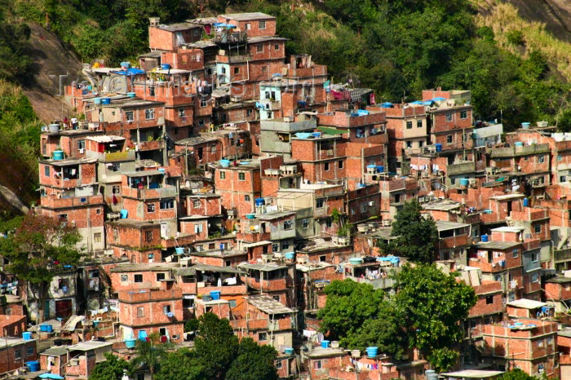


Living Space

Slide 28

Clothing

Slide 29

Clean Water
Life Straw

Slide 30


Transportation
Monorail- move large amounts of people without increasing traffic
Maglev

Slide 31




Other resources
Medicine- unicef, doctors without borders
Fossil Fuels
  Electricity
  Heating
  All transportation

Slide 32





Exotic Species
Introduced, not-native to a particular area
Changes food webs
Out-compete native species

Slide 33
5.2 Conservation of Biodiversity

Slide 34
Conservation Biology
Study and implementation of methods to protect biodiversity (save the species)
Natural Resources- any part of the environment useful to organisms
  Renewable- replaced by natural processes
  (anything living, sun, O2)
  Non-Renewable- available in limited amount
  (Fossil fuels, soil, metals)

Slide 35

Protection of Species
US Endangered Species Act (1973)
  Cannot harm or use land where they live
CITES
  International agreement (120 countries)

Slide 36


Protection of Species
Preserving Habitats
  National Parks- protect natural environments
Habitat Corridors
  Protected strips of land allowing the movement of organisms from one area to another

Slide 37




Protection of Species
Reintroduction Programs
  Brown Pelican (DDT)
  Black-footed Ferret (Prairie dogs)
Captivity (Zoos)
  Ginko, Panda

Slide 38


Cars- Battery Power
100 miles on a single charge ($1 per charge)
Uses 1/5 energy of gasoline car
0 to 60 in ten seconds

Slide 39


Cars- Hydrogen Power
Same power as gasoline car
Emission is water
Drawbacks: 200 miles per fueling / fuel stations

Slide 40


Flex Fuel- E85 Ethanol
Ethanol comes from fermenting corn
Pros- Uses renewable resource (Corn)
Cons- Requires energy to refine and farm
- increases the price of food

Slide 41




Solar Power
Cars have less power
  Mazda converted
    60 miles/hr
    20 mile range
  Cheap running costs
  Expensive to buy or convert

Slide 42





Solar Power

Slide 43
Water Powered Energy
Water Power
http://www.youtube.com/watch?v=iMrRKFETsbo

Slide 44
Other sources of Energy
Nuclear
  Pro- no air pollution, small amount of fuel
  Con- radioactive material (dangerous)
Geothermal
  Pro- no pollution, no cost for fuel, 24 hrs/day
  Con- only used in certain places
Hydroelectric
Wind

